Slide 1

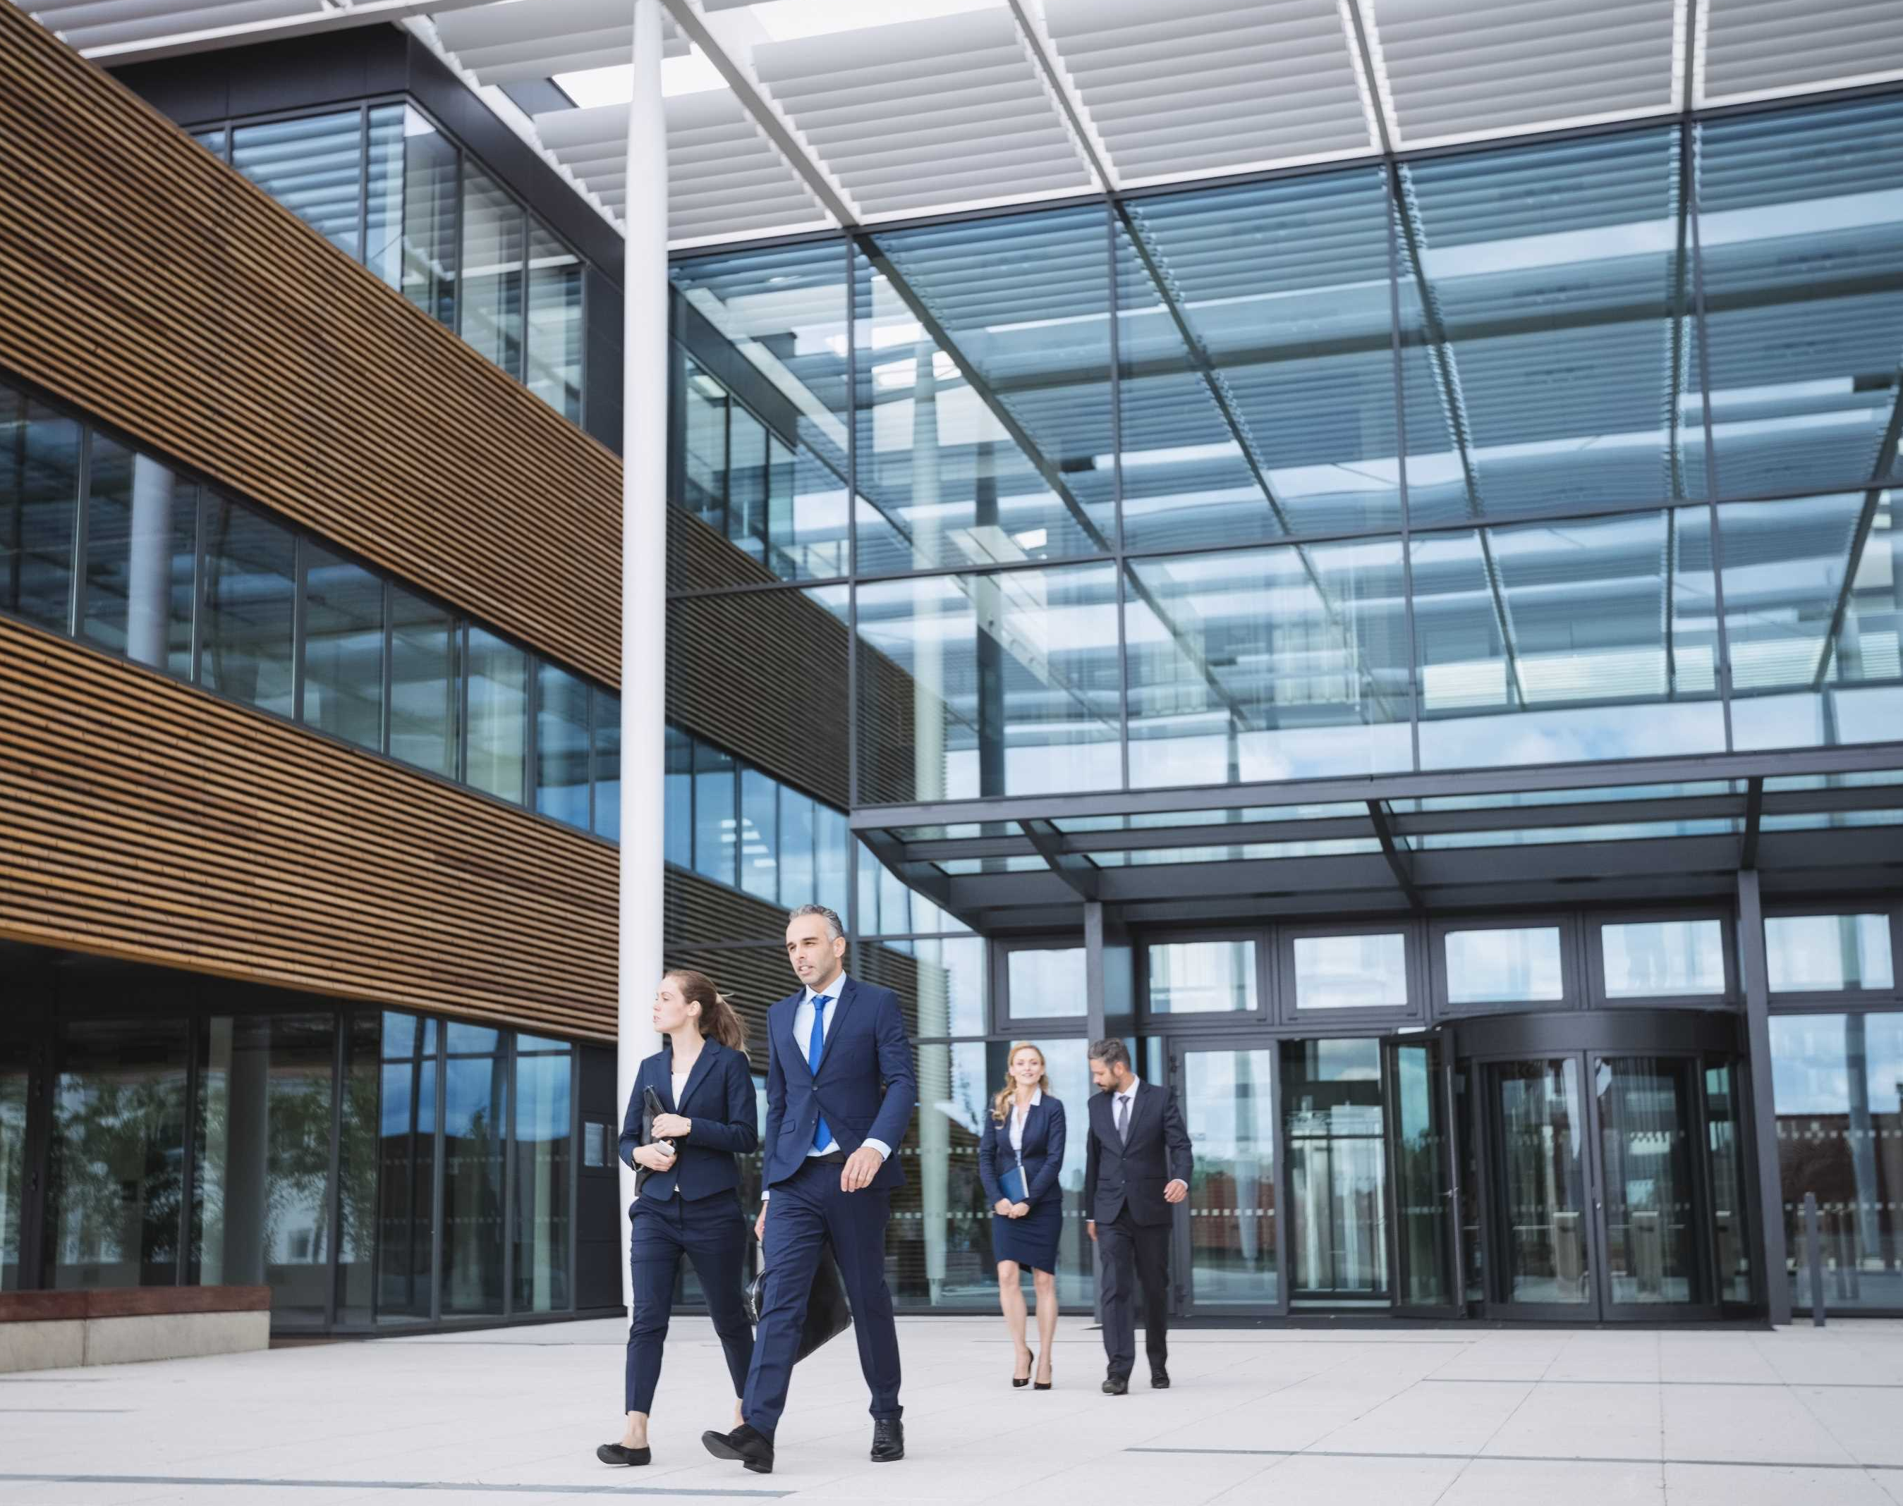
Teehzone Corporation
We focused to provide surveillance solutions.

Slide 2

About Our Company
We are a leading company committed to delivering innovative surveillance solutions and exceptional services to our valued customers. Our expertise spans surveillance Industry, and we strive for excellence in every aspect of our operations

Slide 3

History
Founded 2021, our company has grown from a small startup to a prominent surveillance company. Our journey is marked by perseverance, strategic expansion, and a strong commitment to customer satisfaction.
01
02
03
Established 2021
Steady Growth
Customer Centric Approach

Slide 4



Mission And Vision
Mission
To empower individuals and businesses through innovative technologies and exceptional services, driving positive change in society.
Vision
To be a best survilliance company our industry, recognized for our commitment to excellence, customer satisfaction, and making a meaningful impact on the world.

Slide 5

Our Goals
01
Driven by innovation and excellence, our goal is deliver high-quality products/services and create long-term value for our customers.
02
Our goals are to innovate continuously and deliver exceptional customer service to drive long-term success
03
We strive to achieve sustainable growth and make a positive impact on the world through our products and services

Slide 6

What We Do
delivering survilliance best security solutions our clients. Through innovation, dedication, and a customer-centric approach, we strive to make a positive impact in the markets we serve.
Project Work
Efficient project planning for best survilliance solutions.
01
Service
As we are in electronic survilliance sector we know how service is important and we are corely focused on service.
02
Quick Solution
We provide quick solution on priority basis to our clients.
03

Slide 7

Our Services
We offer a survilliance products with installation & service.
01
Our experienced team provides high-quality & quick service to our clients.
02
Our customer service team is available 24/7 to provide timely and effective support to our clients.
03

Slide 8

Our Process
1
High-quality products/services, customer satisfaction, and cost-effectiveness are at the core of our business process.
2
We prioritize efficiency, innovation, and continuous improvement to stay competitive in the industry.
3
Our commitment to sustainability and social responsibility guides our business decisions and practices.

Slide 9




Address
Office no 5, First floor ,Sukhwani Fortune, Gharonda Residency Morwadi Pimpri
Pune :411018
Contact Number
8108997836/7558534177
Email Address
teehzonecorporation@gmail.com

